Slide 1

BRAIN TUMOR SEGMENTATION
Presented by :-
Rahul Kumar
Roll Number : 180101243
2018005024.rahul@ug.sharda.ac.in
Under the Supervision of :-
Ms. Deepti Sahu
deepti.sahu@sharda.ac.in
Assistant Professor CSE
Yatender
Roll Number : 180102032
2018009735.yatender@ug.sharda.ac.in
Jitesh
Roll Number : 180102028
2018014918.jitesh@ug.sharda.ac.in
DEPARTMENT OF COMPUTER SCIENCE & ENGINEERING
SCHOOL OF ENGINEERING AND TECHNOLOGY

Slide 2
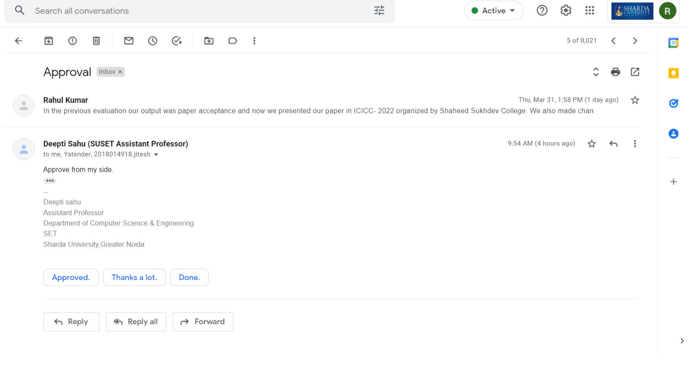
Approval from guide for the evaluation

Slide 3
Introduction
Brain is an autonomous system that controls the entire body functionality.
As brain is tightly enclosed inside skull making it difficult to approach for study and diagnosis purposes.
The only optimal solution to this problem is the use of ‘Image segmentation’.
Computed Tomography and Magnetic Resonance image – used for identification of brain tumor (for image segmentation).

Slide 4
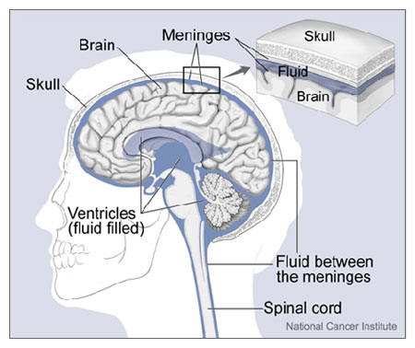
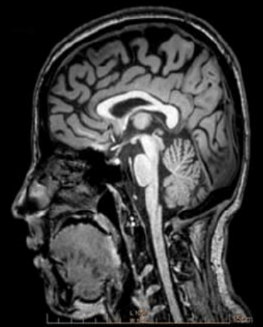
(a.) Skull’s anatomical structure
(b.) MR Image of a head in sagittal view

Slide 5
Disorder: Tumor
Tumor is an abnormal growth of cells that changes the normal structure and sometimes also behavior of the organ.
Brain tumor has tendency to destroy all or most of the normal brain cells.
Tumor occupies most of the brain part resulting in inflammation, swelling and increased pressure within the skull.

Slide 6
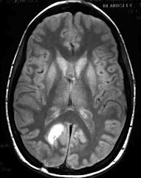
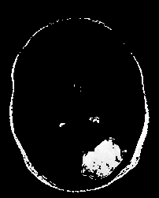
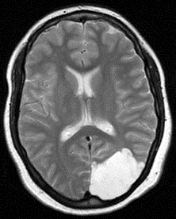
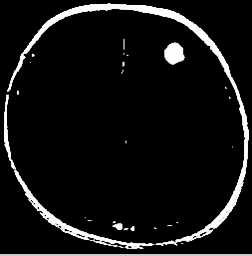
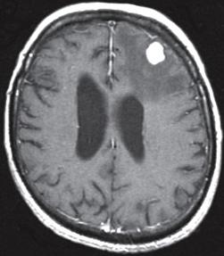
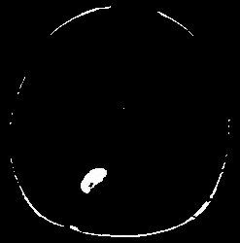
Lesions
(a)(b)(c) Tumor Images
(d)(e)(f) Isolated Tumor after Segmentation

Slide 7
Motivation
We chose this project keeping in mind
The unprivileged population from poor class
India’s expensive diagnosis
And its developing medical sector.
Poor who could not afford doctors fee for chronic tissue related diseases like Cancer, Tumor.
We aim to make Tumor identification from MR images costless and in least time with most accuracy even in primeval stage.

Slide 8
PROBLEM STATEMENT
To detect and locate brain tumors through image.
Our model will detect tumors from the MRI image and then if a tumor exists, we will further locate the lesion in the brain.

Slide 9
objective
Tumor Identification and Detection -
Preprocessing
Segmentation
Tumor Detection
Feature Extraction and Classification

Slide 10
PREPROCESSING
Improve MR Image quality and make it in a form suited for further processing by human or machine vision system.
Preprocessing helps to improve certain parameters of MR images such as the Signal-to-Noise ratio, Visual appearance Enhancement, Removing the irrelevant noise, Undesired parts in background, and preserving its edges.
SEGMENTATION
The preprocessed brain MR image is converted into a binary image with a threshold for the cut-off.
The pixel values greater than the selected threshold are mapped to white, while others are marked as black; due to this, two different regions are formed around the infected tumor tissues, which is cropped out.
In order to eliminate white pixel, an erosion operation of morphology is employed.
Finally, the eroded region and the original image are both divided into two regions and the black pixel region extracted from the erode operation is counted as a brain MR image mask.

Slide 11
TUMOR DETECTION
Hybrid Approach - K means and improved Fuzzy C-means (FCM) algorithm for detecting human brain tumors in a magnetic resonance imaging (MRI) image.
K-means algorithm is used to emphasize segmentation through the proper selection, based on gray-level intensity of image.
The updated membership is determined by the distances from cluster center to data points using the fuzzy C-means (FCM) algorithm while it contacts its best result.
FEATURE EXTRACTION AND CLASSIFICATION
Intensity, shape and texture features for MRI images are extracted and used for classification.
Features from preprocessed image are extracted in such a way that maximum similarity can be achieved within the class to minimize intra class similarity.
Image classification is important in automated diagnosis system to separate the normal image from the defective one.

Slide 12
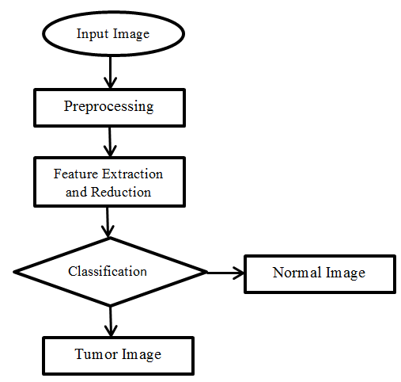
Project structure

Slide 13
Proposed Mechanism
Filters are used for Image Preprocessing purpose. They also help locating tumors.
K-means machine learning method based on Centroid defining theory.
Used for Proper selection of heterogenous parts with clusters to emphasize segmentation initially.
Fuzzy C-means could be used to verify brain tumors for accuracy.
Fuzzy C-means distributes updated membership obtained by calculating distance from cluster center to the data point.

Slide 14
Advantages
The proposed approach is more computationally efficient,
Higher degree of selection.
Better results for overlapped data sets.
Applicable to a variety of tumor forms.
When compared to previous graph-cut and grow-cut approaches, it achieves 80-90 percent overlap with minimum user intervention.
Automated segmentation and tumor detection of brain MRI images.

Slide 15
Limitations
These techniques can help the physicians to non- invasively detect the tumor but still
Different artifacts (Motion artifacts and ring artifacts, etc.)
Intensity inhomogeneity or bias-field noise
Partial volume effect
Local noise due to electronic devices affect the accuracy of tumor detection.

Slide 16
Existing Systems
“Adaptive fuzzy segmentation of magnetic resonance images”:
Conventional FCM has limitation of imperfection to the abnormality of brain.
FCM is incapable in working with images having noise.
“Enforcing temporal consistency in Deep Learning segmentation of brain MR images”:
This method focuses on including the subject in the frame with random cropping scheme.
Augmentation manipulates image in various ways like resizing, flipping and rotating, etc.

Slide 17
Future scope
This technique can be applied for ovarian, breast, lung, skin tumors.
This technique can be developed to classify the tumors based on symmetry.

Slide 18
Workload distribution of the team
Yatender – Algorithm analysis, Project Structuring, Script Integration in MATLAB.
Rahul – Program Implementation, Documenting Research Paper, Collecting test images.
Jitesh – Program implementation, Searching algorithm scripts.

Slide 19
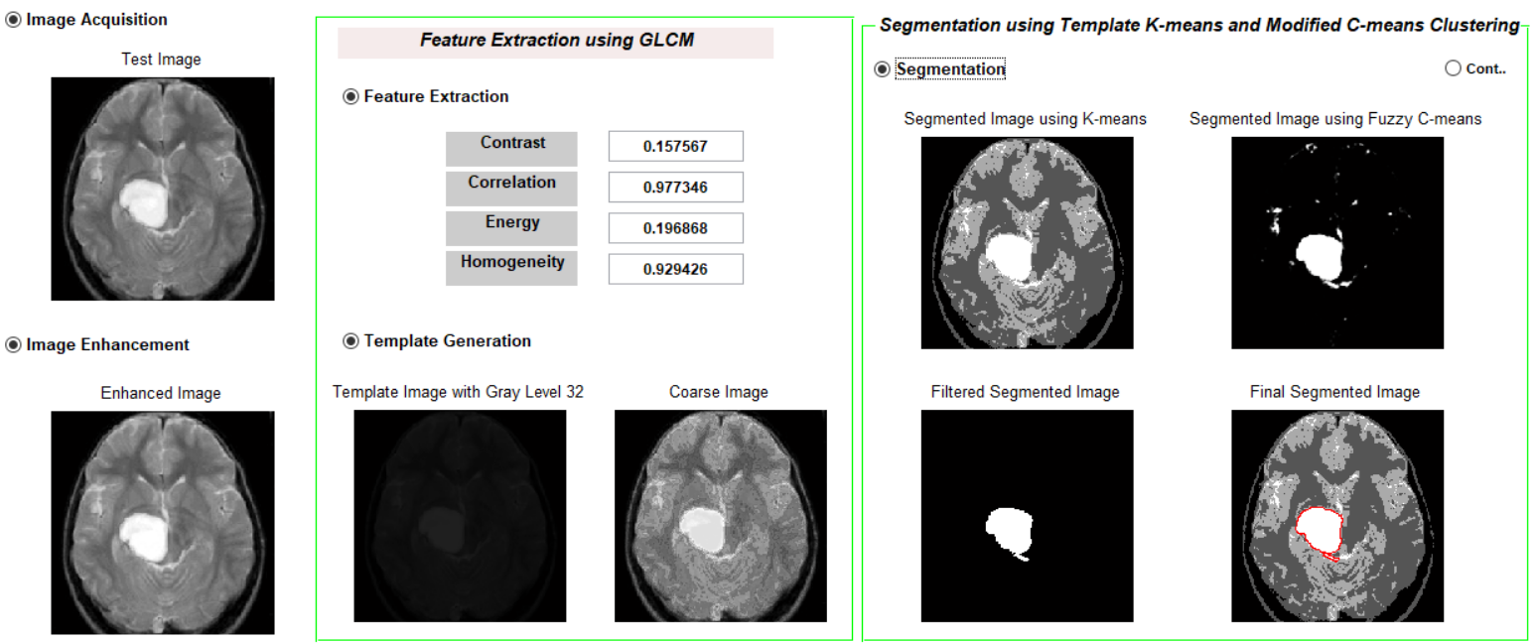
Work done from the last evaluation
Integrations of various MATLAB code scripts that helped in implementation of hybrid approach.
OUTPUT:

Slide 20
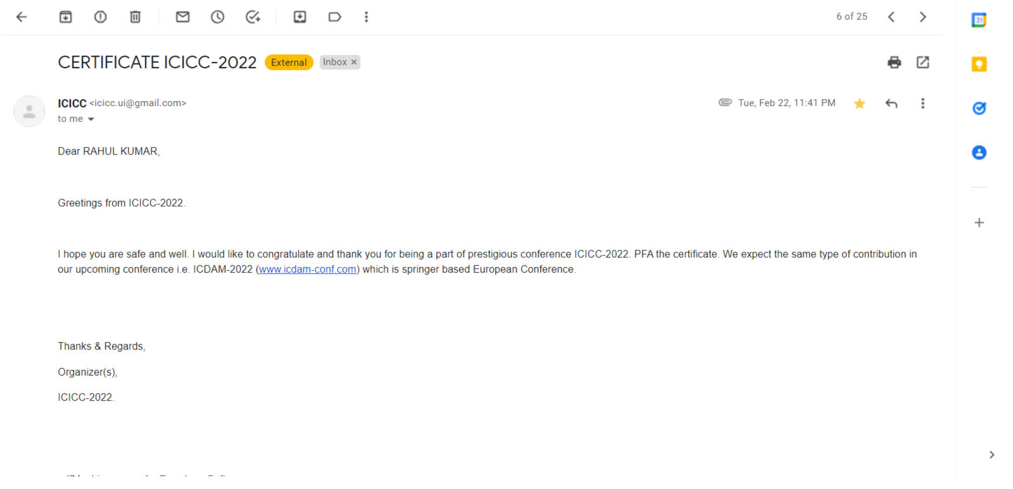
Proof of paper accepted

Slide 21
Thank You
For your precious time

